Slide 1
open world program 2023 republic of Georgia
&
Valley view rotary club
October 13-21, 2023

Slide 2
What is open world?
Funded by Congressional Office for International Leadership (COIL)
Brings leaders from 21 post-Soviet countries to the US to:
  Stay in Host homes to experience US home life
  Learn how we address social issues through contact with US business, government, educational institutions, civic & community leaders
Builds international relationships

Slide 3
What is open world?
Allows delegates to “see America from the inside out”
Has hosted 30,000+ leaders since 1999
Engages many organizations as hosts:
  Universities & community colleges
  Rotary clubs
  Sister-city associations
  Local government agencies
  International visitor councils
  Nonprofits

Slide 4
arrangements
Host 5 delegates + 1 Facilitator in Rotarian homes
Interpreter hired by COIL stays in hotel
Arrival Friday & departure Saturday (8 days)
Host plans:
  Weekend social activities AND
  Monday-Friday meetings with:
    Government
    Educational
    Community
    Volunteer
    Nonprofit organizations on country’s chosen issue

Slide 5
arrangements
COIL pays for all airfare & interpreter expenses
COIL reimburses host organization expenses up to $4580:
  $320 In-home COVID test kits
  $420 Cultural/ticketed events
  $3840 Transportation & meals for the delegation

Slide 6
timeline
9/14/22: Learned of Open World
  29 pages of date/country/theme choices
  21 countries
  98 opportunities JAN-DEC. Examples:
    Armenia: Technology & the Rule of Law
    Kyrgyzstan: Human & Civil Rights
    Moldova: Medical University Partnerships
    Poland: Combating Domestic Violence & Sexual Assault
    Ukraine: 5 pages of issues, such as Treating Battlefield Injuries, Agricultural Planning Post War, Advancement in Prosthetics and Women’s Veterans Issues

Slide 7
timeline
Application Deadline: October 3
  Select date/country/theme
  The toughest application requirement:
DECISION: Insufficient time to analyze & submit in 18 days!
BUT – Not ready to give up!

Slide 8
2nd Chance
10/19: Asked to be notified of possibilities after evaluation of on-time submissions
11/28: Notified of two 2023 opportunities:
  October 13-21 with Republic of Georgia
  December 1-9 with Kyrgyzstan
Selection: Republic of Georgia
  Theme: Volunteerism & Civic Action
  Specifically: Resocialization & rehabilitation of former prisoners

Slide 9
Research
Application due 12/12 (in 14 days)
MAXIMUM sense of urgency!
Knowledge of this topic = 0
Thankful for Google search to identify organizations
12/12/22: Submitted application
12/20/22: Approved
Planning begins!

Slide 10
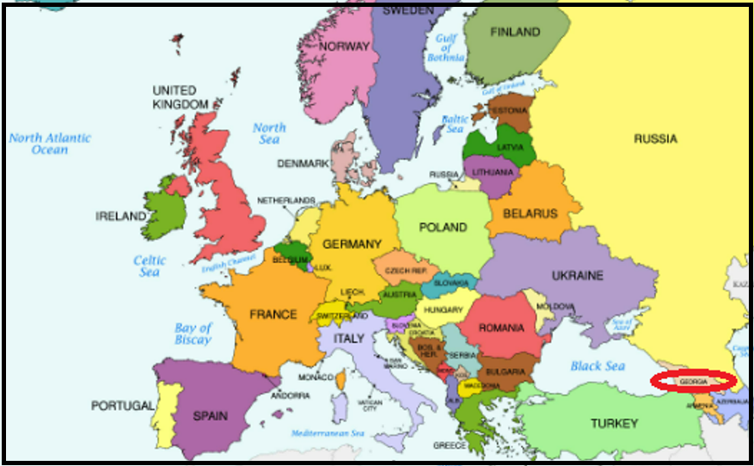
Where is Georgia?
Smaller than South Carolina
Population: 3.7 million
Languages:
Georgian, Russian, English

Slide 11
INITIAL REVIEW
Received 250+ pages of info from national office
Many components to this Program AND
Many government regulations to be followed
Very different from RFE!
So we quickly came to a realization……

Slide 12

To successfully complete a project like this!

Slide 13
Asked for club help!
Broke the workload down into “chunks”
Requested Primary & Backup coordinator for each category:
Host Families | Media
Social Activities | Club Meeting
Transportation | Medical/Emergency
Financial
Monday – Friday Schedule with Organizations/Experts

Slide 14
goals
Educated our club in 1/18 meeting
All Coordinators volunteered in that meeting
Individual meetings scheduled for each category
Set target of 5/31 to have all rules reviewed & schedules with outside organizations locked in
Planned to request $3K in grants to give back to nonprofits generously donating time to the project

Slide 15
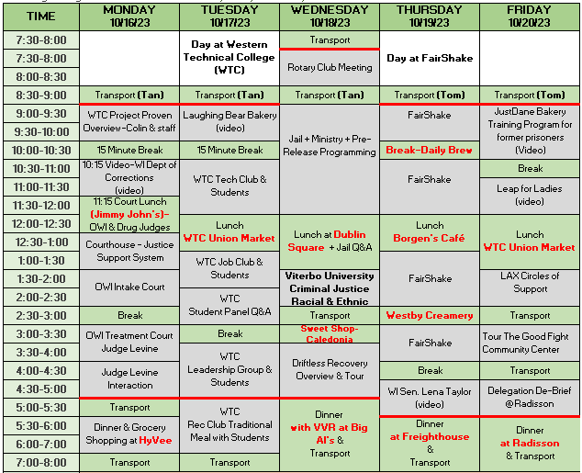
What we achieved by may 1

Slide 16
Email News on may 18
Dear Shari,
Yesterday we received a rather disappointing notification from the Congressional Office for International Leadership (COIL) announcing cancellation of all OW local programs from October through December 2023. The program has run into financial difficulties and will need to take time to re-group.

Slide 17


Slide 18
Spurred to action
Dates/times/locations had been locked down with more than 20 organizations
Had to find a way to make it happen!
Entered into 3 weeks of negotiations
End result: June 7 Agreement to proceed IF Valley View would pay $12,000 for airfares

Slide 19
New funding challenge
$5K Rotary Works Foundation Grant Request
$5K District Grant Request
$2K Request to VVR Board
ALL APPROVED!
Planning continued

Slide 20
delegates
8/21 received delegate profiles
Ages 29-32
2 fluent in English, the rest conversational
Georgian agencies represented:
  Vocational Education & Training Center for Inmates
  Department of Resocialization & Rehabilitation of Convicts
  National Agency for Crime Prevention, Execution of Non-Custodial Sentences & Probation
Arranged video call 9/19
Ready for delegation arrival October 13!

Slide 21
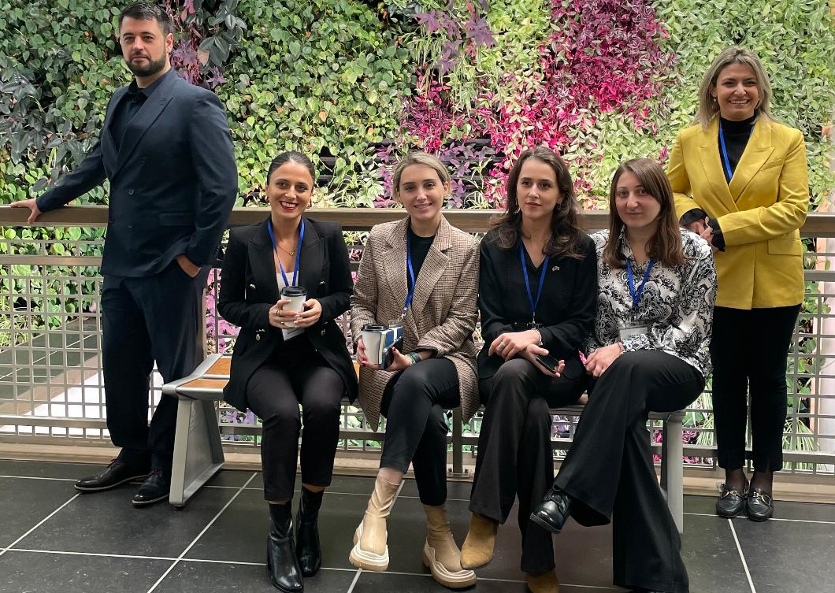
Our new Georgian family
Beka
Ani
Khatia
Salome
Tamta
Dodo

Slide 22
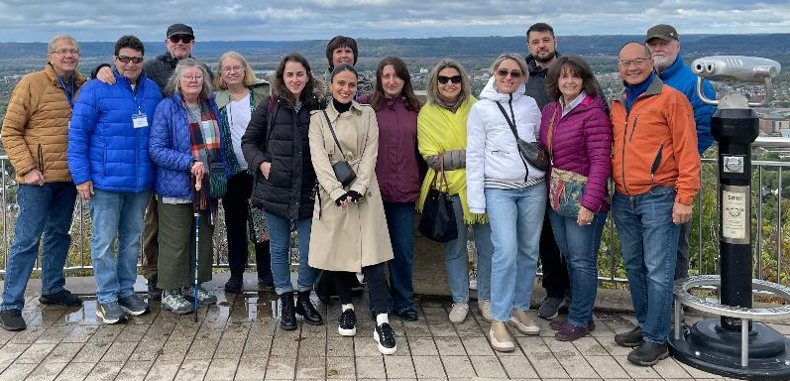
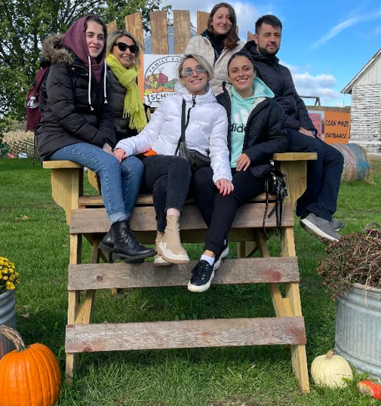
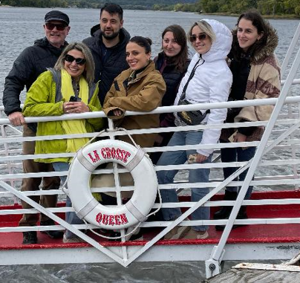
Weekend fun

Slide 23
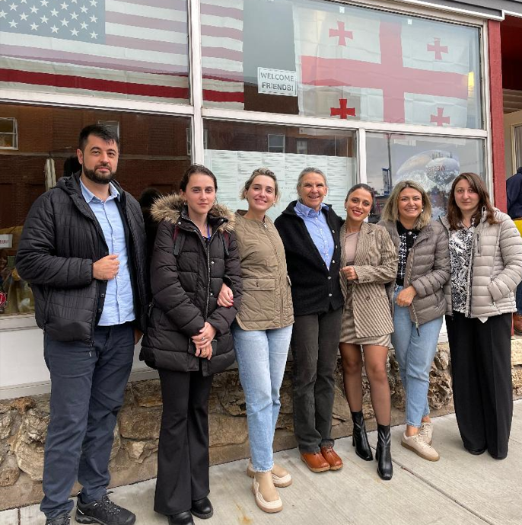
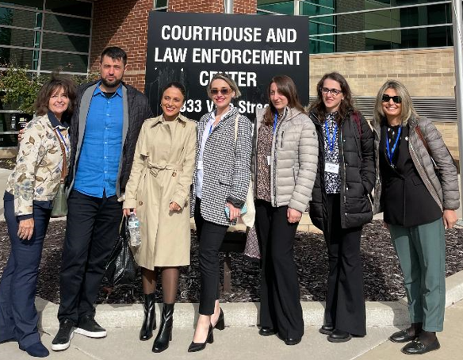
Weekday learning

Slide 24
Life-changing experience
Amazing learning experience for all of us: delegates & Rotarians
Made lifelong friendships with delegates
Created new professional relationships with government, community, educational and nonprofit organizations in LAX & beyond
Learned so much about Georgia

Slide 25
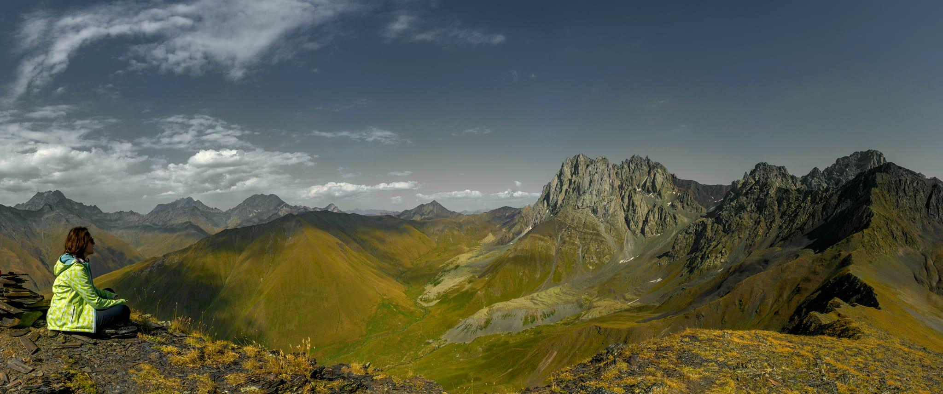

Geography
Entire country is more temperate than other countries at its latitude due to the Caucasus Mountains
The Black Sea helps moderate the temperature in the west
Georgia’s unique geography has played a vital role in its growth as a nation and people
https://www.youtube.com/watch?v=ecmvz7yauuM
Georgian Traditional Dance Performed By Sukhishvili Georgian National Ballet - YouTube

Slide 26
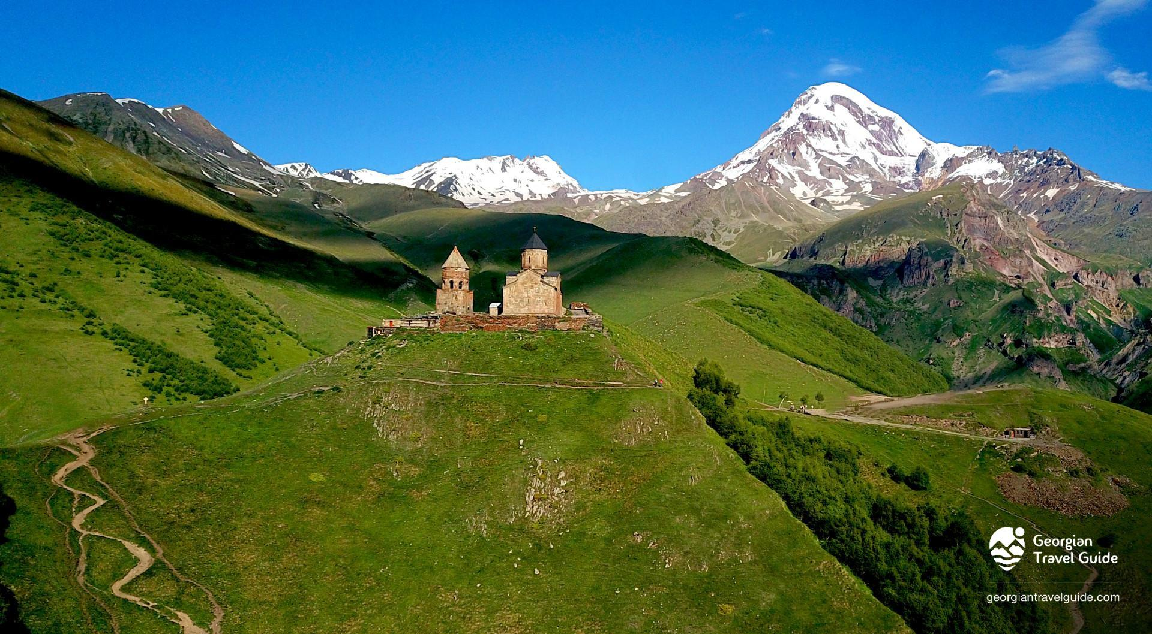
Geography
History
Georgia has continually been at the crossroads of Empires and trade routes
Zezva and Mzia are the oldest European skeleton remains & were found in Georgia
Golden age –King Tamar, the only female king of the Bagrationi dynasty
It’s the country of Golden fleece & is best known from the story of Jason and the Argonauts in Greek mythology
Most of the history of Georgia can be summed up in one word: invasion
20% of the country is occupied by Russia!

Slide 27

4-Way Test on Georgia project
Of the things we think, say or do:
Was it the TRUTH?
Was it FAIR to all concerned?
Did it build GOODWILL and BETTER FRIENDSHIPS?
Was it BENEFICIAL to all concerned?”
PLUS #5: Was it fun?

Slide 28
What’s next?
Helping delegates create satellite Rotary Club
Ongoing communication with our new family
Hope to do an RFE with them in future
Need more information on our experience?
  Contact me:
      Shari Laffredi
      262-488-0021
      slaffredi@yahoo.com

Slide 29


Slide 30


